Slide 1


Deep Learning-Based Approach for Automated Biometric Identification of Mugger
Crocodiles
CSE641 Computer Vision: Modern Methods and Applications
Group 5: Shalvi Modi, Daksh Shah, Sloka Thakkar

Slide 2
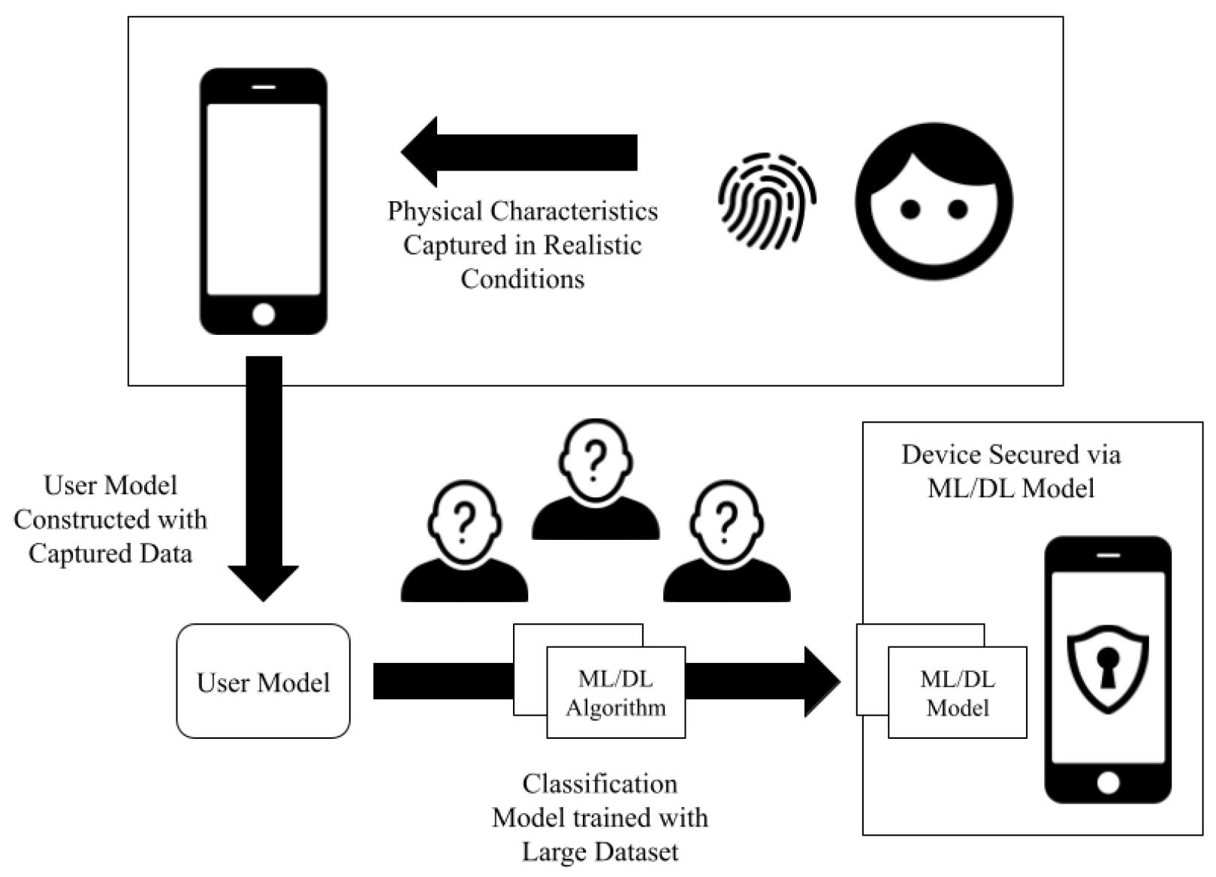
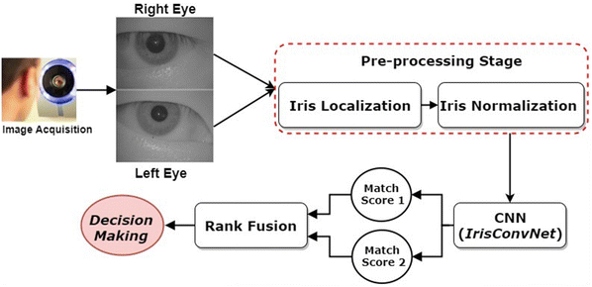

Background
Fig.2 [2]
Fig.1 [1]
[1]Kokal, S., Vanamala, M., & Dave, R. (2023). Deep Learning and Machine Learning, Better Together Than Apart: A Review on Biometrics Mobile Authentication. Journal of Cybersecurity and Privacy, 3(2), 227-258. https://doi.org/10.3390/jcp3020013
[2]Al-Waisy, A.S., Qahwaji, R., Ipson, S. et al. A multi-biometric iris recognition system based on a deep learning approach. Pattern Anal Applic 21, 783–802 (2018). https://doi.org/10.1007/s10044-017-0656-1

Slide 3
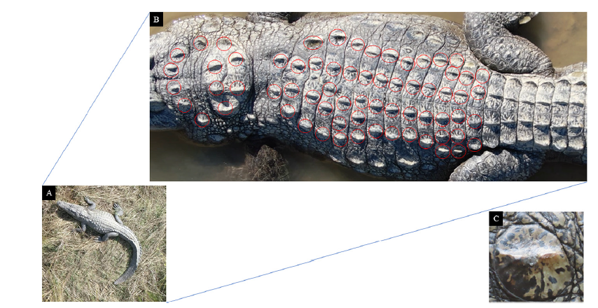
Literature Survey
Machine learning-based biometric identification offers non-invasive alternatives to traditional wildlife tagging. CNNs have been used for species like tigers and chimpanzees, but mostly in controlled environments. Limited research exists on free-ranging crocodilians.
Fig.4 [3]
[3]Ghosal, Ratna & Shah, Supan & Patel, Arpit & Patel, Vaishwi & Raval, Mehul & Desai, Brinky. (2022). Identification of free-ranging mugger crocodiles by applying deep learning methods on UAV imagery. 10.5061/dryad.s4mw6m98n.

Slide 4
Literature Survey
Paper Name | Approach | Key Features | Relevance
Identification of free-ranging mugger crocodiles by applying deep learning methods on UAV imagery [3] | UAV-based CNN model (YOLO-v5l) for identifying free-ranging mugger crocodiles using dorsal scute patterns. | High accuracy in distinguishing individuals; Non-invasive approach using UAVs; Model showed 89.2% accuracy. | Basis for using UAVs and CNN for crocodile identification in free-ranging environments.
From crowd to herd counting: How to precisely detect and count African mammals using aerial imagery and deep learning?[4] | Deep learning-based remote sensing for wildlife monitoring. | High efficiency in large-scale monitoring; Automates wildlife recognition. | Supports the use of remote sensing and deep learning in animal identification.
Do you get what you see? Insights of using mAP to select architectures of pretrained neural networks for automated aerial animal detection [5] | CNN-based facial recognition for individual identification of primates. | High precision; Works well in controlled conditions. | Demonstrates CNN viability for biometric identification but highlights need for alternative approaches for non-facial species.
Multispecies detection and identification of African mammals in aerial imagery using convolutional neural networks[6] | UAV-based imagery with ML for reptile population estimation. | Effective in identifying large reptiles; UAVs reduce human disturbance. | Reinforces UAV effectiveness for ecological studies on crocodilians.

Slide 5
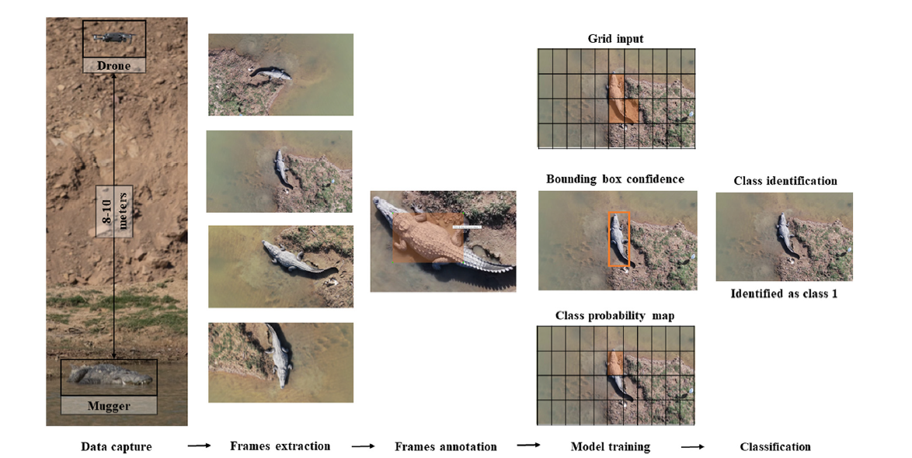
Problem Statement
Using a deep learning approach to automate the biometric identification of Mugger crocodiles, improve accuracy, and analyze the impact of new seasonal data on the model's performance.
Fig.3 [3]
[3]Ghosal, Ratna & Shah, Supan & Patel, Arpit & Patel, Vaishwi & Raval, Mehul & Desai, Brinky. (2022). Identification of free-ranging mugger crocodiles by applying deep learning methods on UAV imagery. 10.5061/dryad.s4mw6m98n.

Slide 6
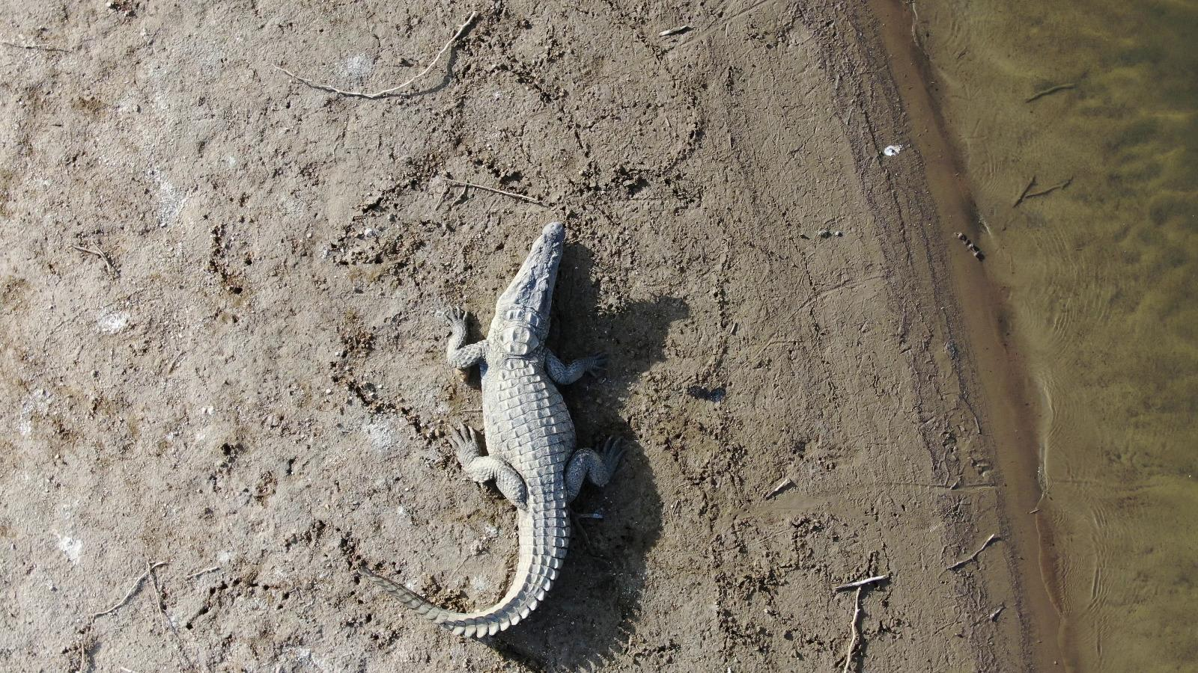
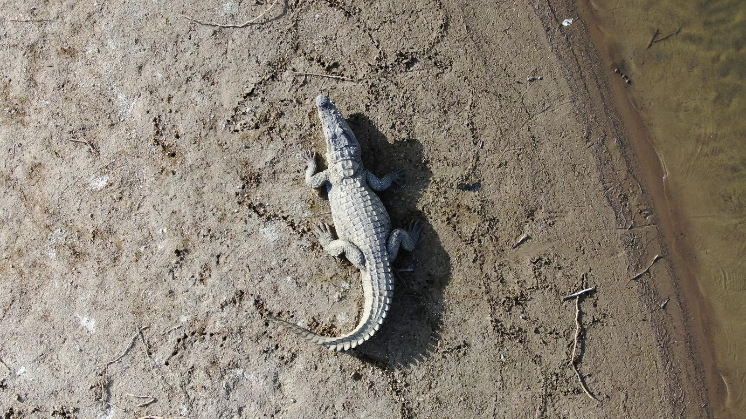
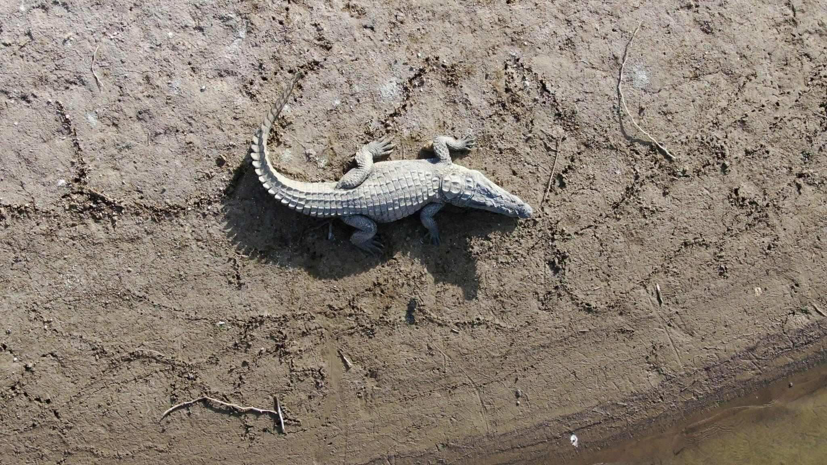
Dataset Discussion
Dataset Size: 88,000 UAV-captured frames
Species: 143 free-ranging mugger crocodiles (~1.5m in length)
Location: 19 locations in Gujarat, India
Drone Used: DJI Mavic 2 Zoom
Camera Specs: 24–48 mm optical zoom
Frame Resolution: 3840 × 2160 pixels at 96 DPI
Flight Height: 8–10 meters
Recording Duration: 30 seconds to 1 minute per session
Flight Pattern: Clockwise rotation
Time of Capture: Between 0800–1600 hours

Slide 7
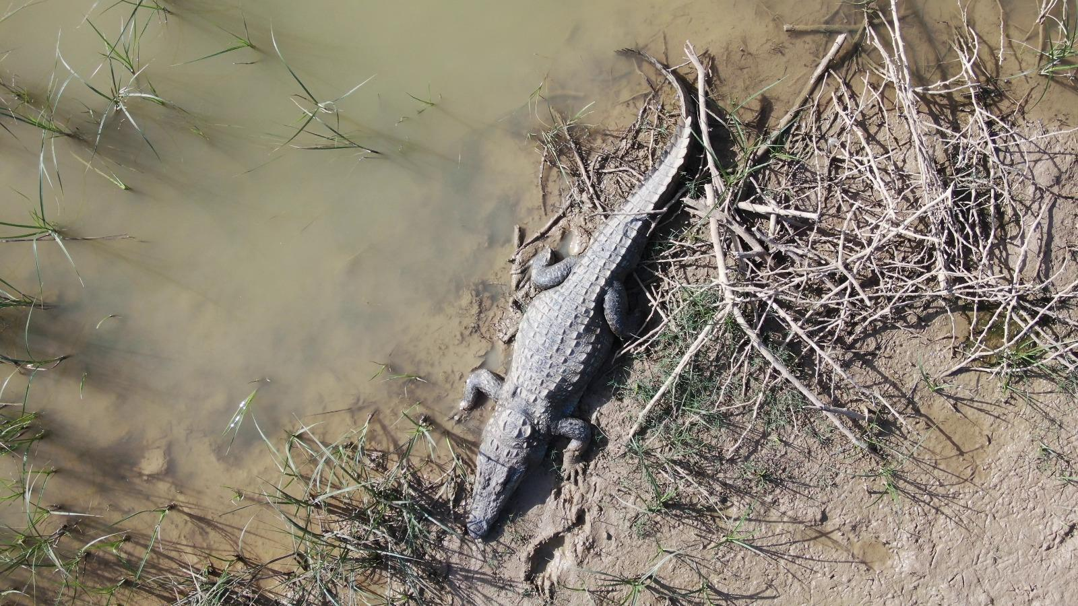
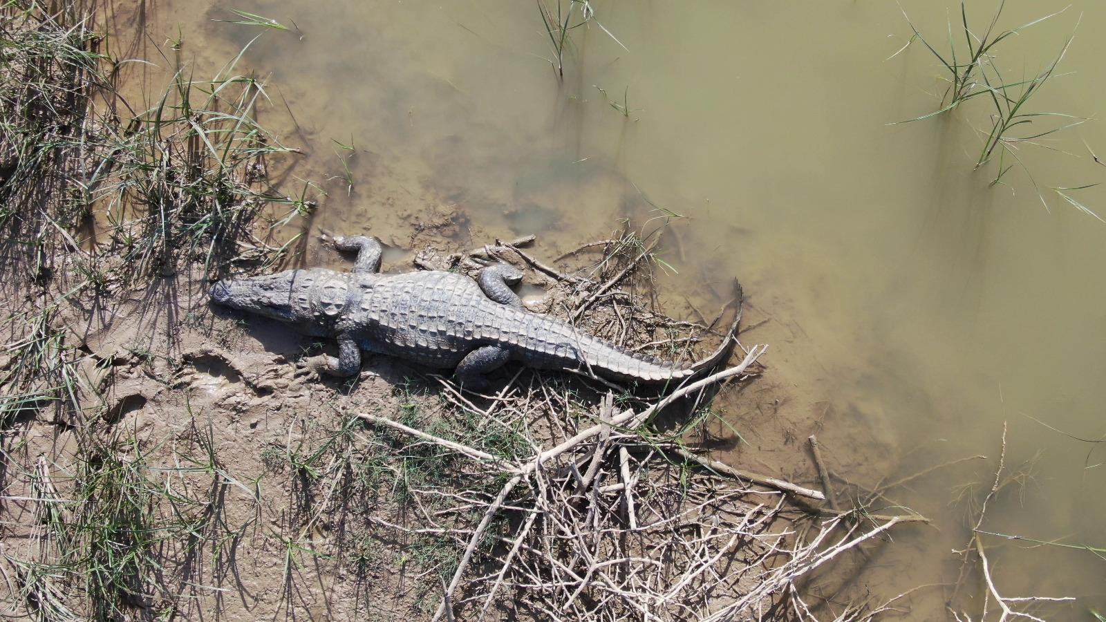
Dataset Discussion
Once a crocodile was spotted, the drone was taken closer to the crocodile focussing on the dorsal scute patterns. OpenCV-Python library used to extract frames from the video clips of 143 muggers.

Slide 8
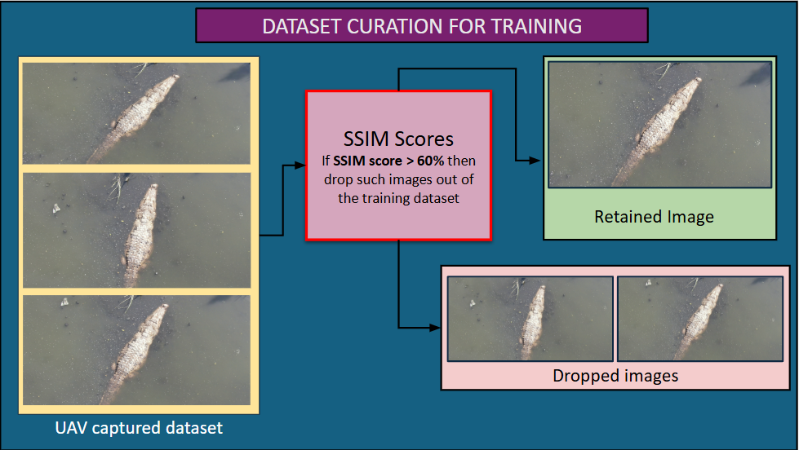
Methodology

Slide 9
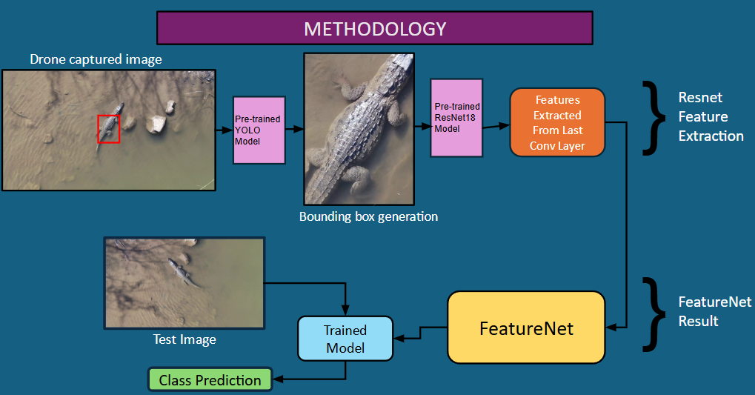
Methodology

Slide 10
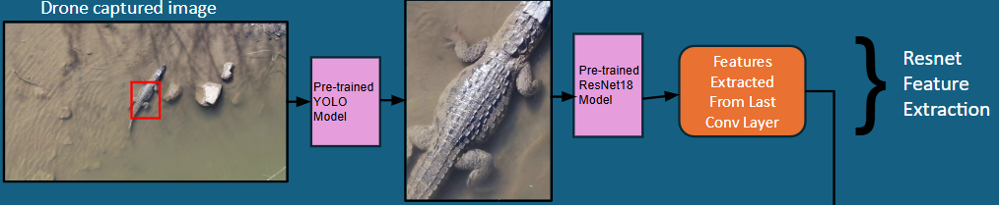
Methodology
UAV captured images are passed through a pre-trained YOLO model detects the bounding box for the mugger crocodile. The detected image is then processed through a pretrained ResNet 18 model, where features are extracted from the last convolutional layer for identification and analysis.

Slide 11
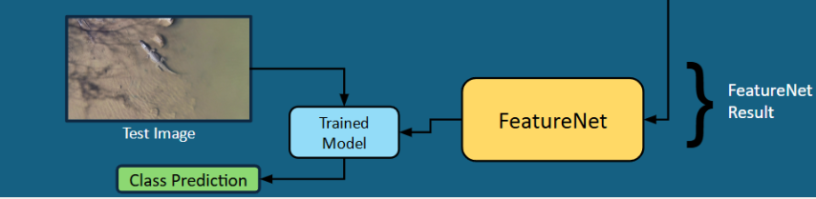
Methodology
A test image is passed through a trained model, which utilizes the extracted features from the last convolutional layer. These features are further processed by FeatureNet, which generates the feature representation. The trained model then uses these processed features to predict the class of the image.

Slide 12
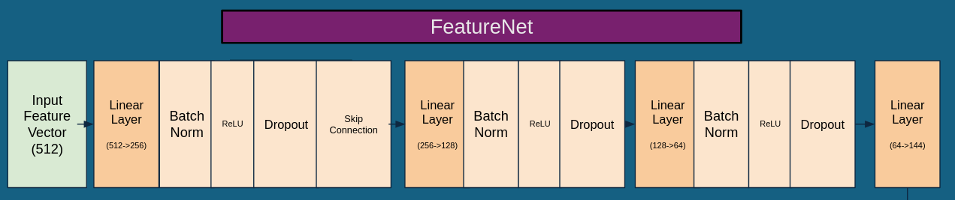
Methodology
FeatureNet processes an input feature vector of 512 dimensions through a series of fully connected (linear) layers with progressively decreasing dimensions: 512 → 256 → 128 → 64 → 144. Each linear layer is followed by batch normalization, ReLU activation, and dropout to enhance generalization and stability. A skip connection is introduced after the first linear transformation (512 → 256) to preserve important features and improve gradient flow. The final linear layer (64 → 144) produces the processed feature representation, which can be used for classification.

Slide 13
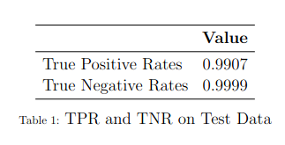
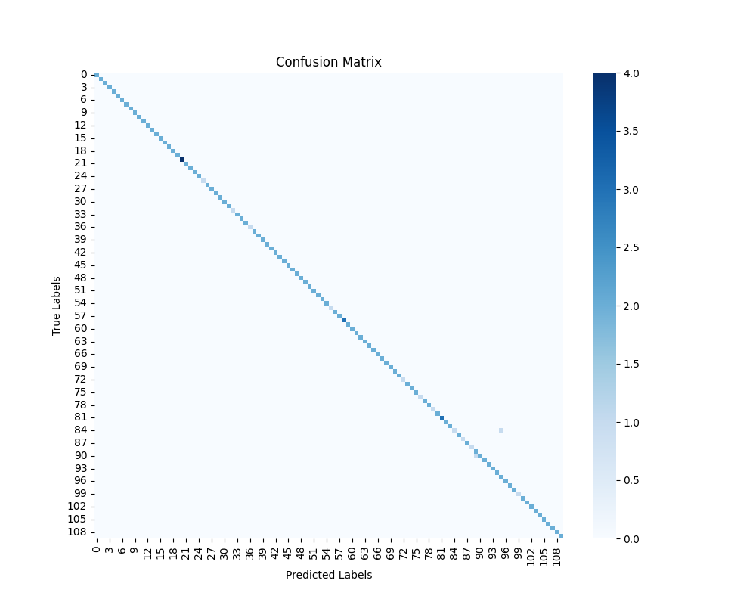
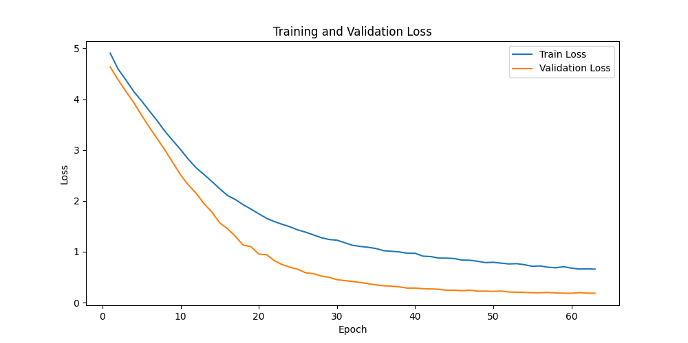
Results

Slide 14
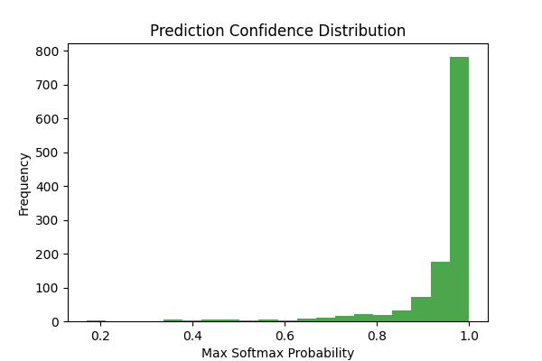
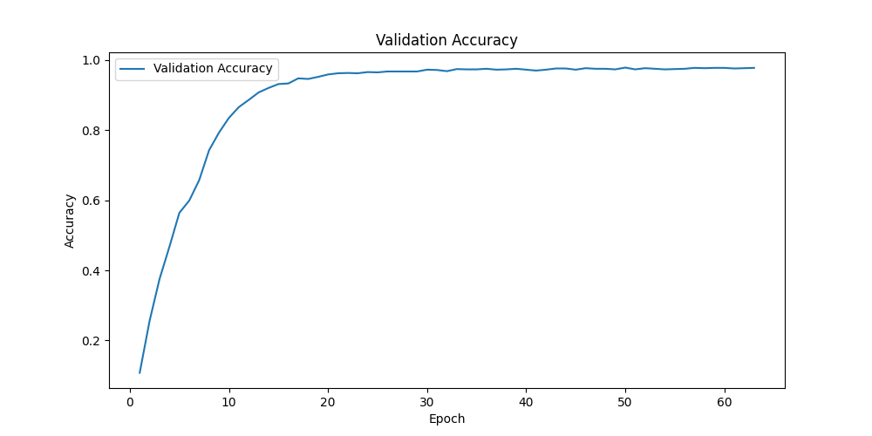
Results
The prediction confidence distribution shows most predictions have high confidence.
The validation accuracy graph indicates a rapid increase followed by stabilization near 1.0.

Slide 15
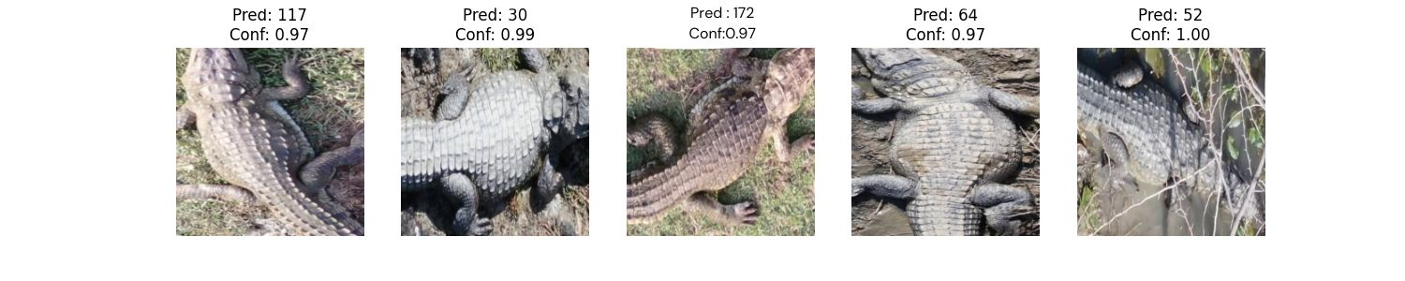
Results
This is the output when a test image is passed in the trained model. The class of the Mugger crocodile is predicted along with the confidence score. The confidence score indicates how much confidence the model has in its predictions.

Slide 16
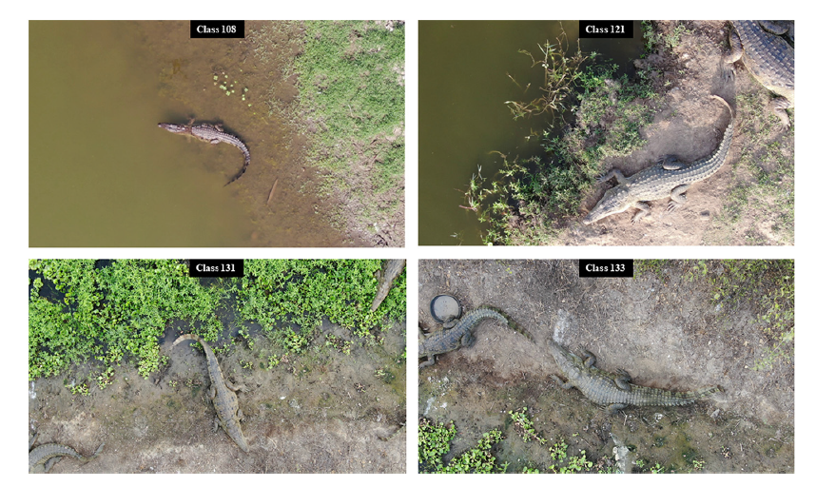
Future Work
We plan to implement a deep learning approach for further optimization. The project will focus on two key aspects:
Results on Old Data – This dataset, used in the original study, consists of single-season data and will serve as a benchmark.
Improving TPR on Old + New Data – Our goal is to enhance the True Positive Rate (TPR) by incorporating new multi-season data, improving identification performance across different environmental conditions.
Use model merging approach for future predictions.
Fig.5 [3]

Slide 17
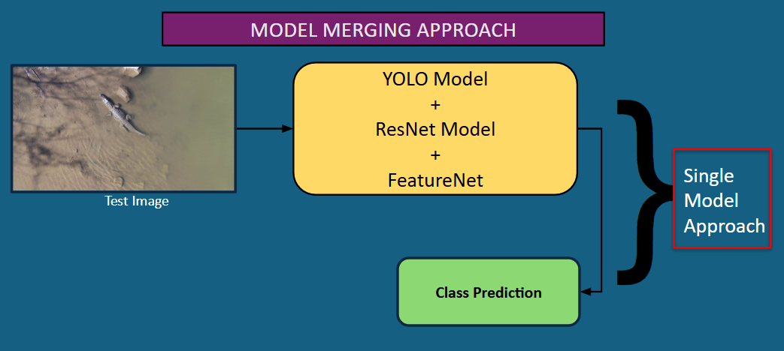
Future Work

Slide 18
References
[1]Kokal, S., Vanamala, M., & Dave, R. (2023). Deep Learning and Machine Learning, Better Together Than Apart: A Review on Biometrics Mobile Authentication. Journal of Cybersecurity and Privacy, 3(2), 227-258. https://doi.org/10.3390/jcp3020013
[2]Al-Waisy, A.S., Qahwaji, R., Ipson, S. et al. A multi-biometric iris recognition system based on a deep learning approach. Pattern Anal Applic 21, 783–802 (2018). https://doi.org/10.1007/s10044-017-0656-1
[3]Ghosal, Ratna & Shah, Supan & Patel, Arpit & Patel, Vaishwi & Raval, Mehul & Desai, Brinky. (2022). Identification of free-ranging mugger crocodiles by applying deep learning methods on UAV imagery. 10.5061/dryad.s4mw6m98n.
[4]Alexandre Delplanque, Samuel Foucher, Jérôme Théau, Elsa Bussière, Cédric Vermeulen, Philippe Lejeune,From crowd to herd counting: How to precisely detect and count African mammals using aerial imagery and deep learning?,ISPRS Journal of Photogrammetry and Remote Sensing,
[5]Moreni, M., Theau, J., & Foucher, S. (n.d.). Do you get what you see? insights of using map to select architectures of pretrained neural networks for automated aerial animal detection. PLOS ONE. https://journals.plos.org/plosone/article?id=10.1371%2Fjournal.pone.0284449
[6]Multispecies detection and identification of African mammals in aerial imagery using convolutional neural networks - Delplanque - 2022 - remote sensing in ecology and Conservation - Wiley Online Library. (n.d.). https://zslpublications.onlinelibrary.wiley.com/doi/10.1002/rse2.234

